Slide 1
Time Series Engression: Modeling Conditional Distributions with Input-Dependent Noise and Temporal Structure
Yuri CROCI
University of Geneva, GSEM, Student in Master of Science in Statistics
14 November, 2025
Supervised by: Prof. Dr. Sebastian Engelke (GSEM)

Slide 2
Overview
Motivation
Literature Review:
Noise Structure Design
Engression Framework
Methodology:
Problem Formulation
Temporal extension
Heteroskedastic extension
Experimental Setup
Experiments:
Simulation Study
River Discharge Application
Conclusions

Slide 3
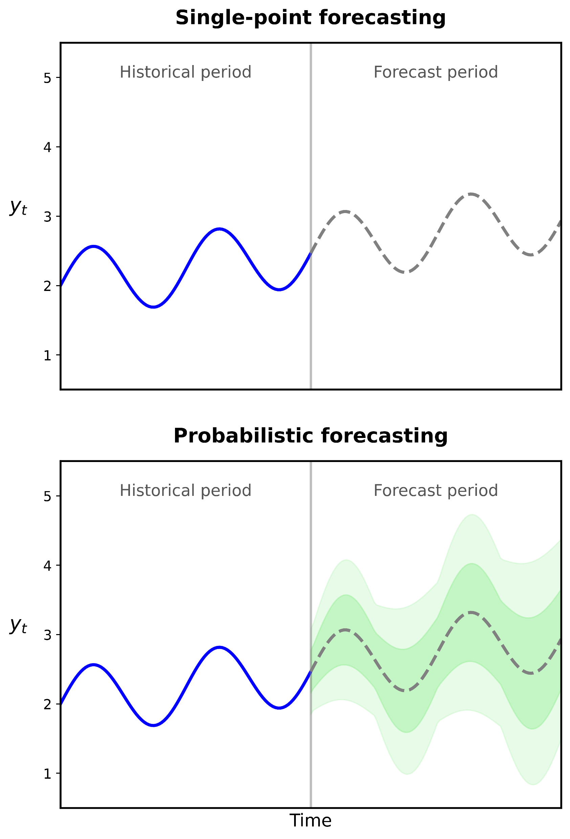
Motivation
The challenges:
Temporal complexity of time series
Limitation single-point forecasting
Trade-off complexity models
What’s needed:
Conditional distribution for temporal forecasting
Non-parametric flexibility
Extrapolation capability

Slide 4
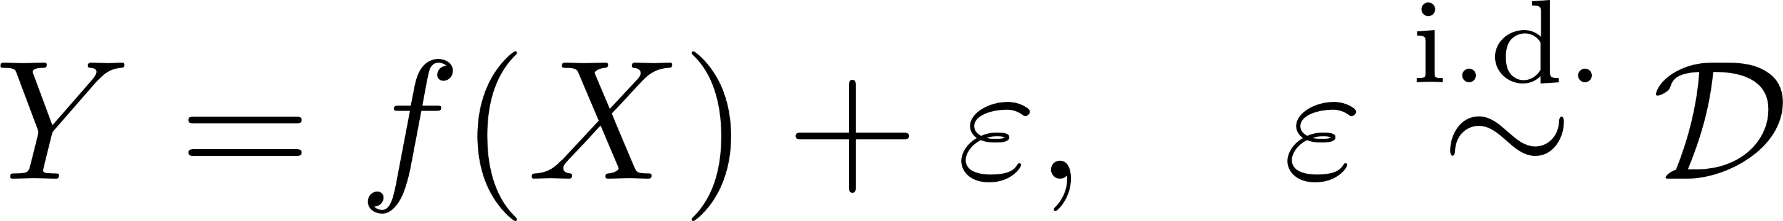
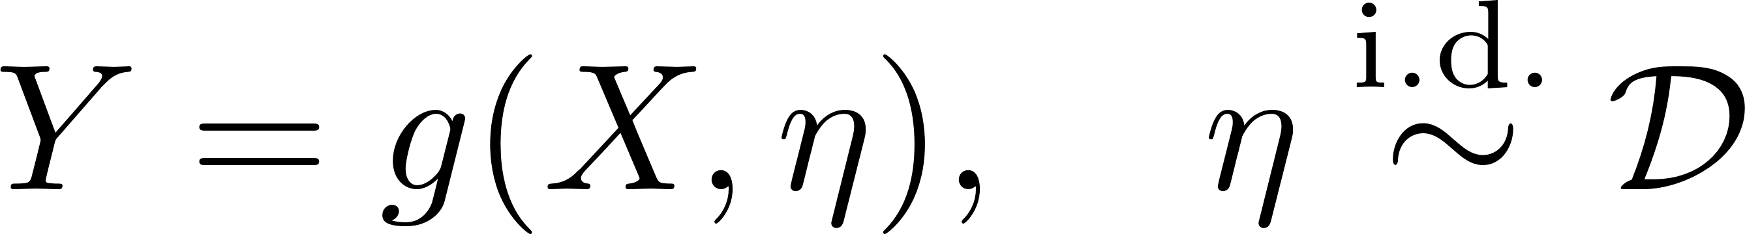
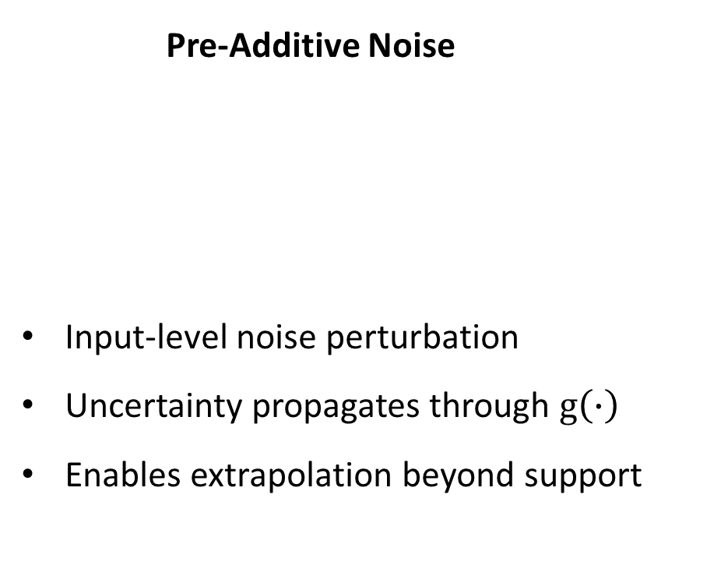
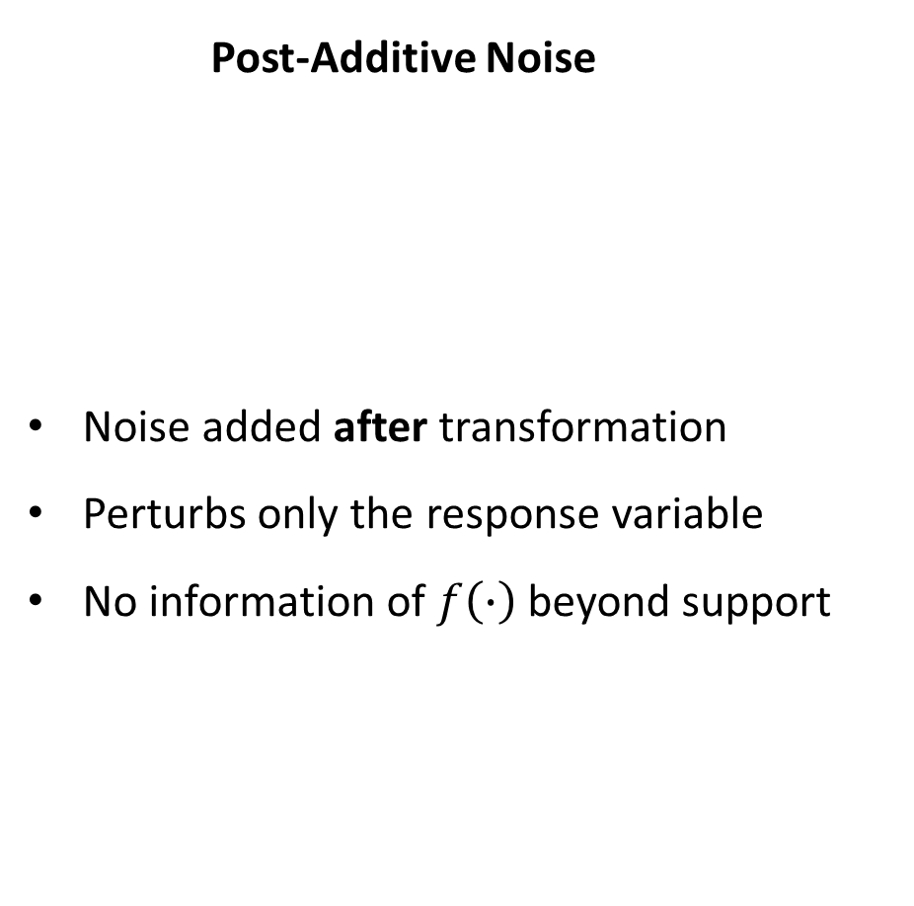
Literature Review: Noise Structure Design
Post-Additive Noise
Noise added after transformation
Perturbs only the response variable
No information of $f\left(∙\right)$beyond support
Pre-Additive Noise
Input-level noise perturbation
Uncertainty propagates through $g\left(∙\right)$
Enables extrapolation beyond support

Slide 5



Literature Review: Engression
Model class:
Given covariates $X$ and response $Y,$ Engression models the conditional distribution $P(Y|X)$ through a general class of functions
Goal: Find $g$ such that
by enabling Sampling-based inference from the estimated distribution.

Slide 6

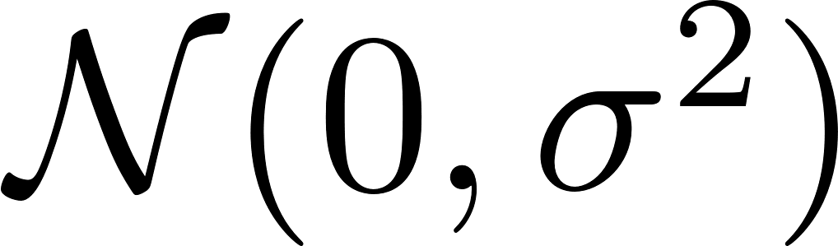

Literature Review: Engression
How: Find optimal $g(∙)$ by minimizing the Energy Loss as proper scoring rule,
where $η$ and $η′$ are independent draws from .
Dual Nature:
Accuracy: Pulls samples toward observations
Dispersion: Spreads samples apart

Slide 7
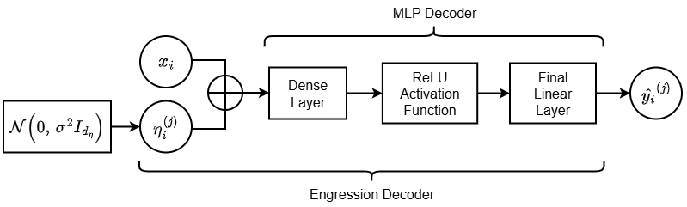

Literature Review: Engression
Implementation:
Forward pass composed by $m$ samples, where each $η_{i}^{(j)}$ produces one prediction $y_{i}^{(j)}$.
Optimized by Adam optimizer under Energy Loss.

Slide 8
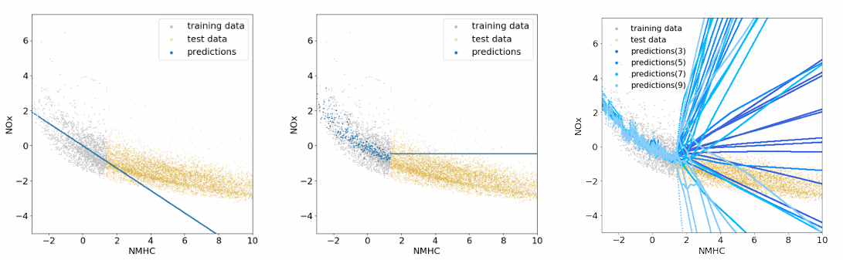
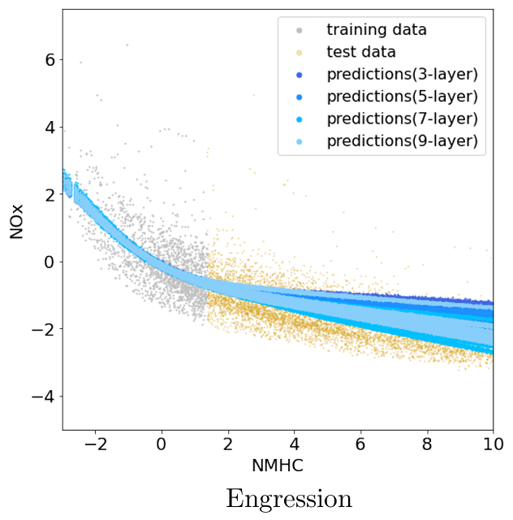

Literature Review: Engression
Extrapolation Capabilities:
Under local monotonic $g(x)$ near boundary, pre-additive structure, and bounded noise.
Recover $g(x)$ between $[{{ x}_{train_min} − η_{min} ; x}_{train_max}+ η_{max}]$.
Robust fallback to linear extrapolation in case of misspecification.
Liner regression
Random Forest
Neural network
regression
Engression

Slide 9

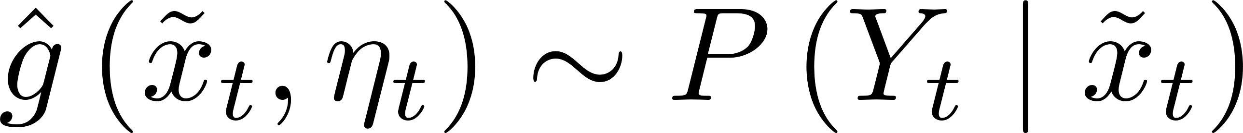
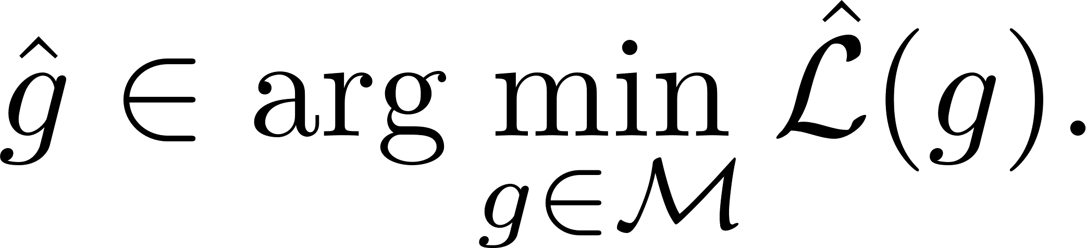
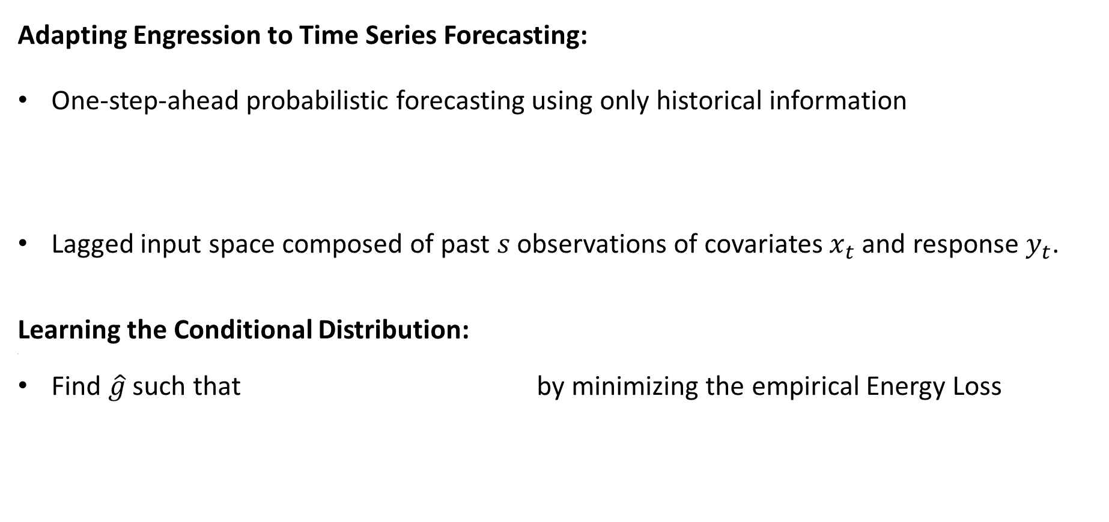
Methodology: Problem Formulation
Adapting Engression to Time Series Forecasting:
One-step-ahead probabilistic forecasting using only historical information
Lagged input space composed of past $s$ observations of covariates $x_{t}$ and response $y_{t}$.
Learning the Conditional Distribution:
m
Find $\hat{g}$ such that by minimizing the empirical Energy Loss

Slide 10
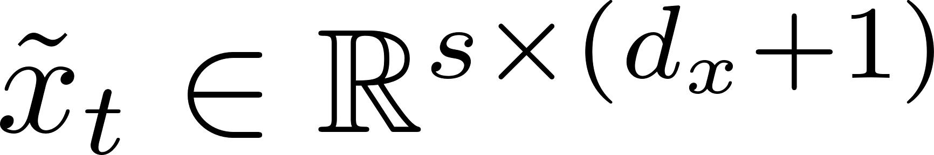
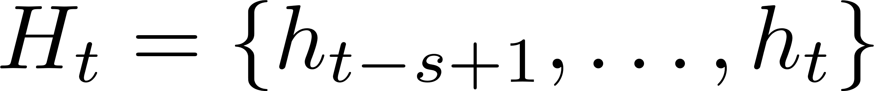
Methodology: Temporal extension
Limitation of Original Architecture:
Treatment of lagged features as independent inputs.
Ignore sequential dependencies in temporal data.
Temporal Encoder with Gated Recurrent Unit (GRU):
Process input sequence through GRU encoder.
Produce hidden states via recurrent architecture.
Able to capture sequential patterns in the historical window.
GRU selected over LSTM for better encoder-decoder balance.

Slide 11

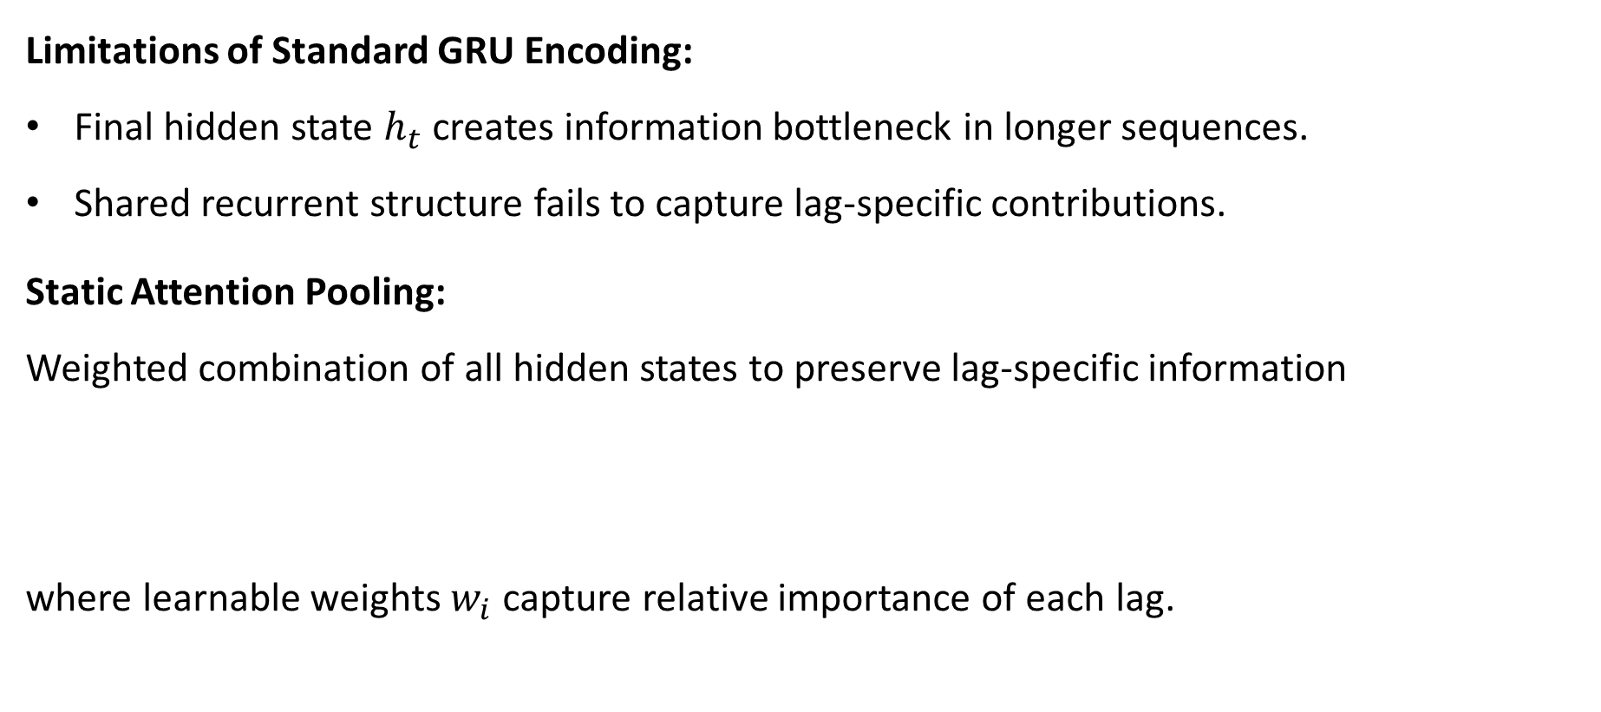
Methodology: Temporal extension
Limitations of Standard GRU Encoding:
Final hidden state $h_{t}$ creates information bottleneck in longer sequences.
Shared recurrent structure fails to capture lag-specific contributions.
Static Attention Pooling:
Weighted combination of all hidden states to preserve lag-specific information
where learnable weights $w_{i}$ capture relative importance of each lag.

Slide 12
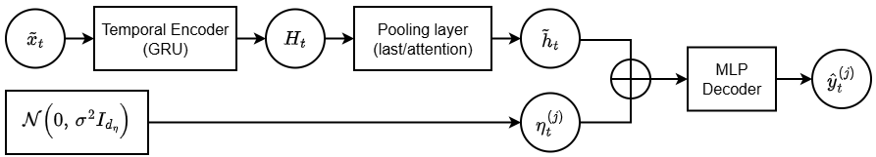
Methodology: Temporal extension
Sequential Engression architecture:

Slide 13
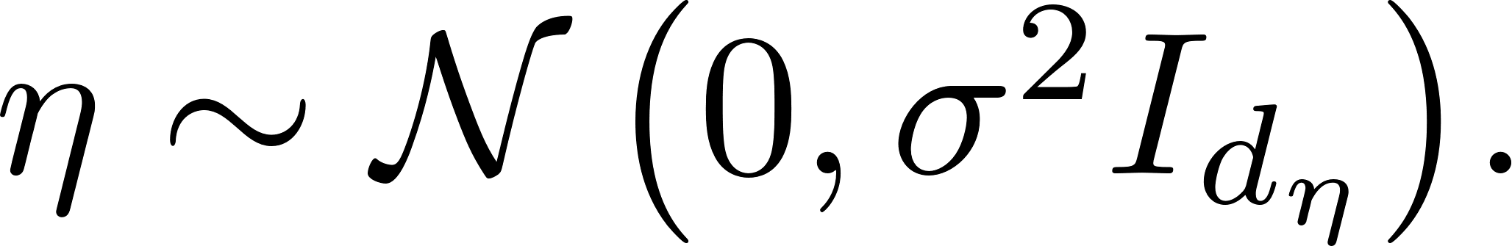
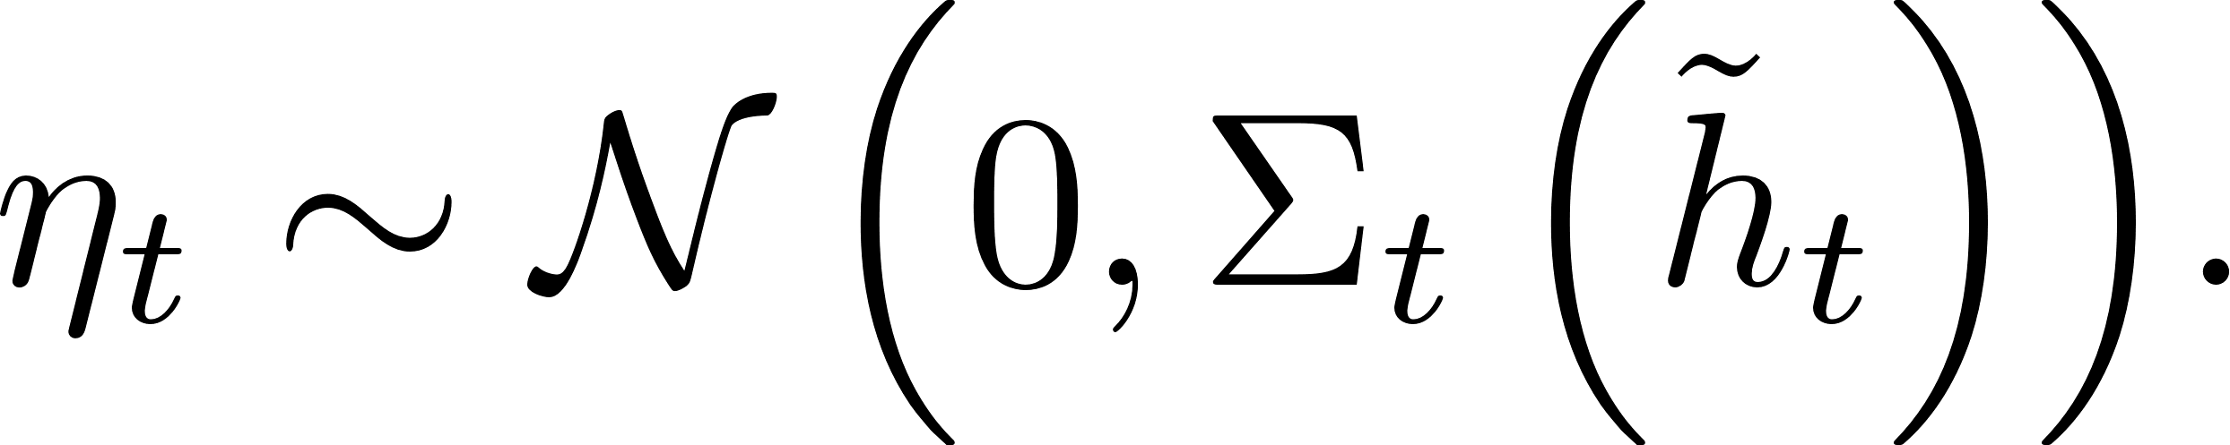

Methodology: Heteroskedastic extension
Limitation of Fixed Noise:
Original framework injects homoskedastic noise
Fails to capture time-varying uncertainty in real-world time series.
Input-Dependent Noise Injection
Learn conditional variance as function of input
Two parameterizations for varying complexity

Slide 14
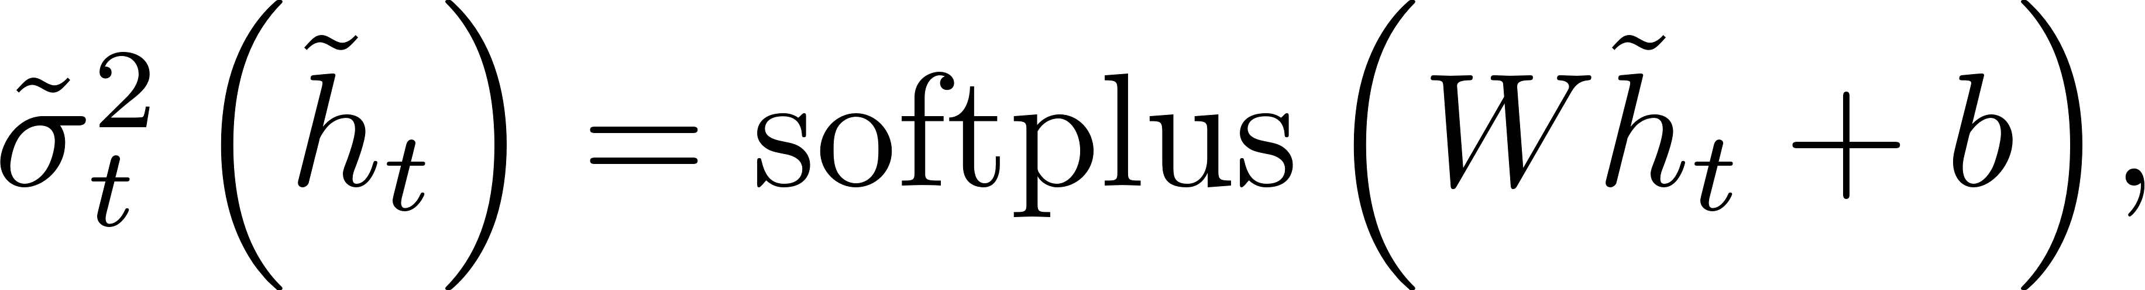
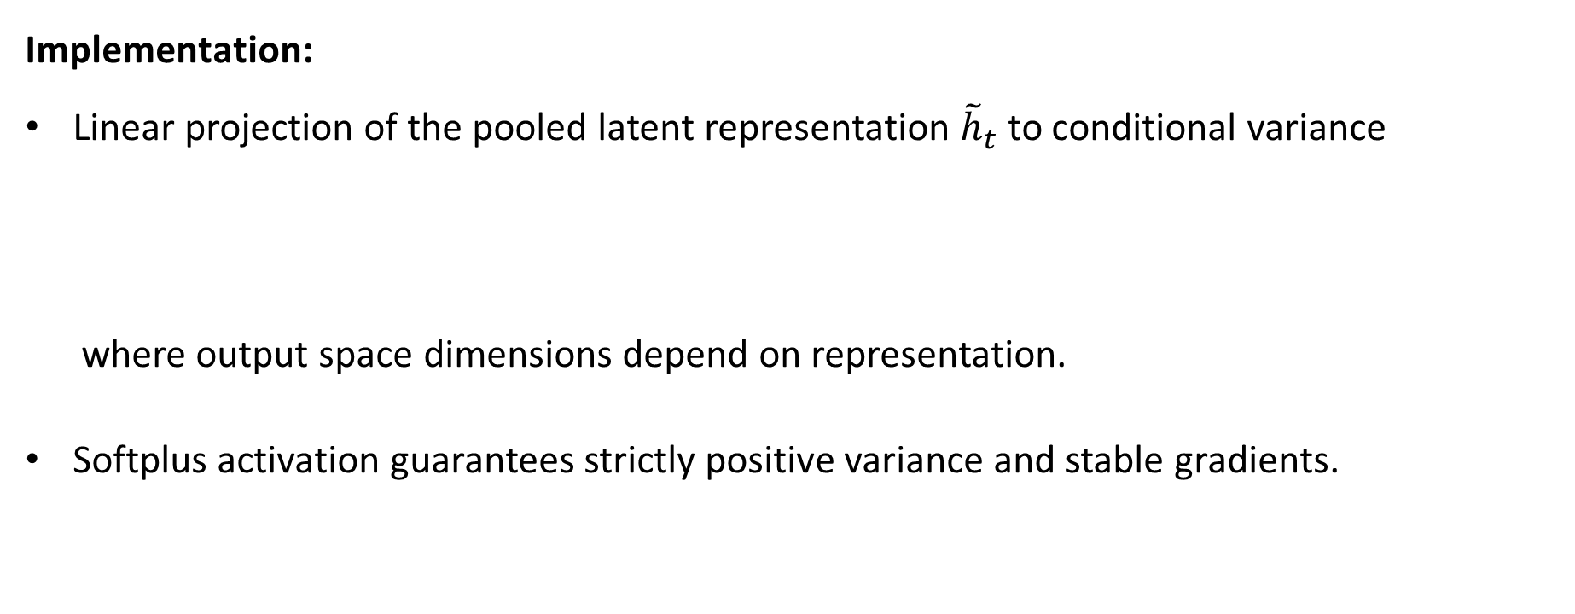
Methodology: Heteroskedastic extension
Implementation:
Linear projection of the pooled latent representation ${\tilde{h}}_{t}$ to conditional variance
where output space dimensions depend on representation.
Softplus activation guarantees strictly positive variance and stable gradients.

Slide 15
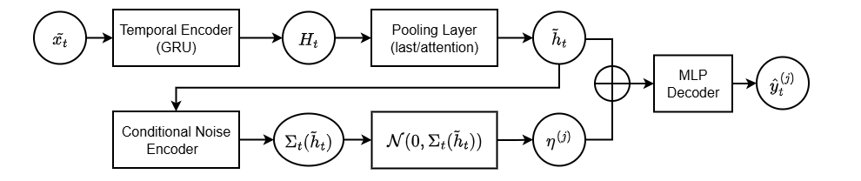
Methodology: Heteroskedastic extension
Heteroskedastic Sequential Engression architecture:

Slide 16
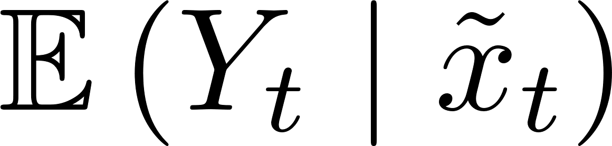
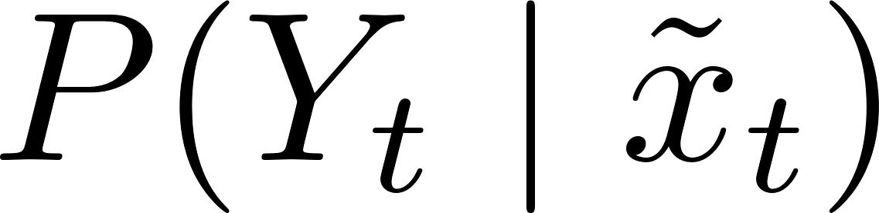
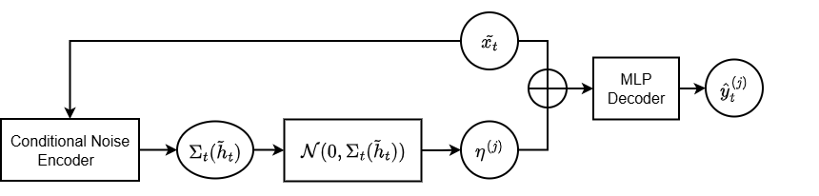
Methodology: Experimental Setup
Model Configurations evaluated:
Deterministic baseline (MLP and Sequential MLP) trained to estimate .
Distributional models (Engression, Heteroskedastic Engression, Sequential Engression, and Heteroskedastic Sequential Engression) trained to estimate .
Heteroskedastic Engression Architecture

Slide 17
Methodology: Experimental Setup
Training & Validation:
Chronological train-validation-test split to preserve temporal order.
Standardization of features for training stability and equal noise perturbation.
Grid search over hyperparameters validated on validation set using respective loss functions.
Early stopping on validation loss to determine optimal number of epochs.
Weight decay tuned as regularization across all models.

Slide 18
Methodology: Experimental Setup
Evaluation Metrics:
RMSE: Mean prediction error
Extreme RMSE: Performance on extreme events (>99.5% training quantile)
Energy Loss: Joint measure of sharpness and calibration
Coverage (PICP₈₀): Calibration of 80% prediction intervals
Sharpness₈₀: Precision of prediction intervals
Quantile RMSE: Accuracy over true quantiles(Q10, Q50, Q90)
Robustness:
All models trained and evaluated across 10 independent seeds
Distributional models
only

Slide 19
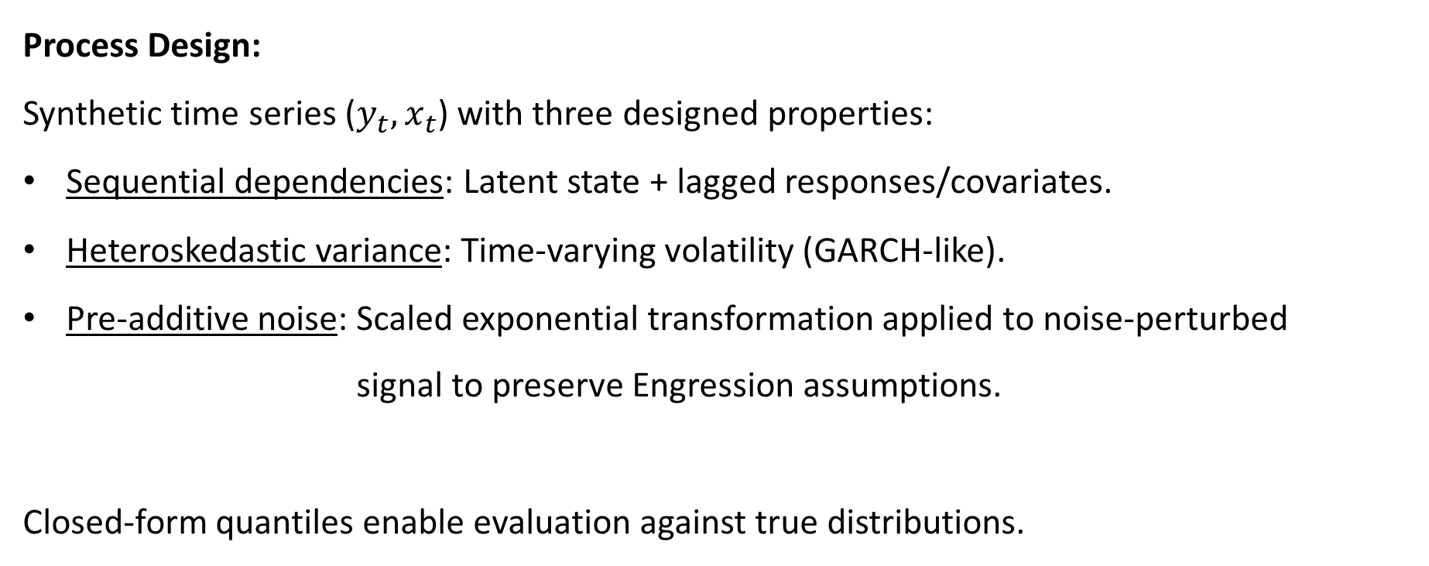
Experiments: Simulation Study
Process Design:
Synthetic time series ($y_{t}, x_{t}$) with three designed properties:
Sequential dependencies: Latent state + lagged responses/covariates.
Heteroskedastic variance: Time-varying volatility (GARCH-like).
Pre-additive noise: Scaled exponential transformation applied to noise-perturbed signal to preserve Engression assumptions.
Closed-form quantiles enable evaluation against true distributions.

Slide 20
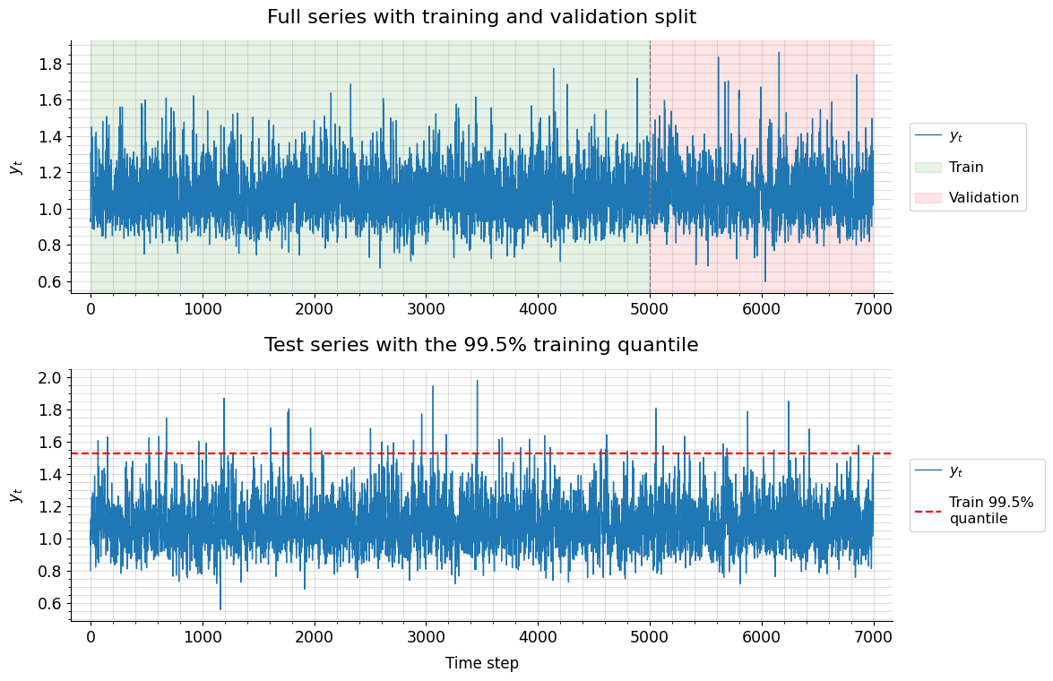
Experiments: Simulation Study
Experimental Setup:

Slide 21
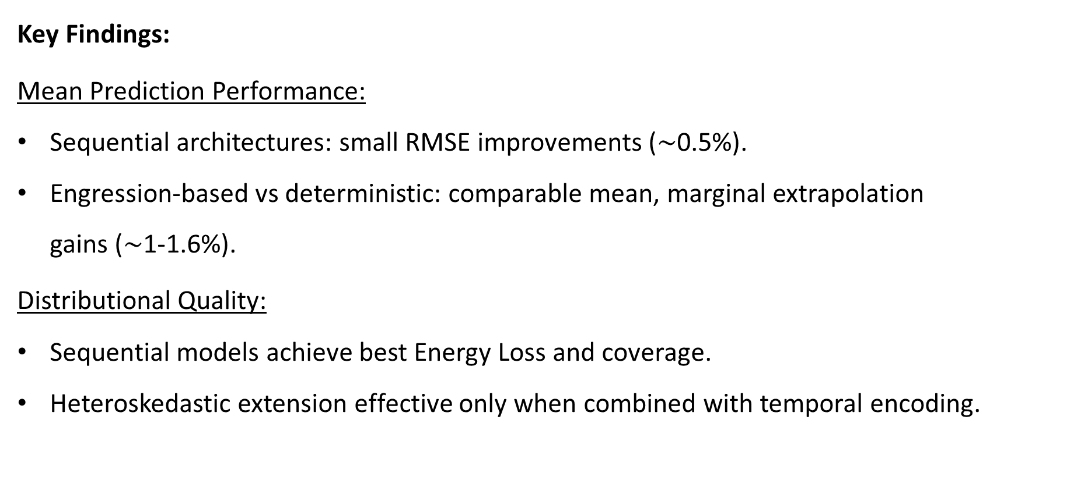
Experiments: Simulation Study
Key Findings:
Mean Prediction Performance:
Sequential architectures: small RMSE improvements ($\sim$0.5%).
Engression-based vs deterministic: comparable mean, marginal extrapolation gains ($\sim$1-1.6%).
Distributional Quality:
Sequential models achieve best Energy Loss and coverage.
Heteroskedastic extension effective only when combined with temporal encoding.

Slide 22
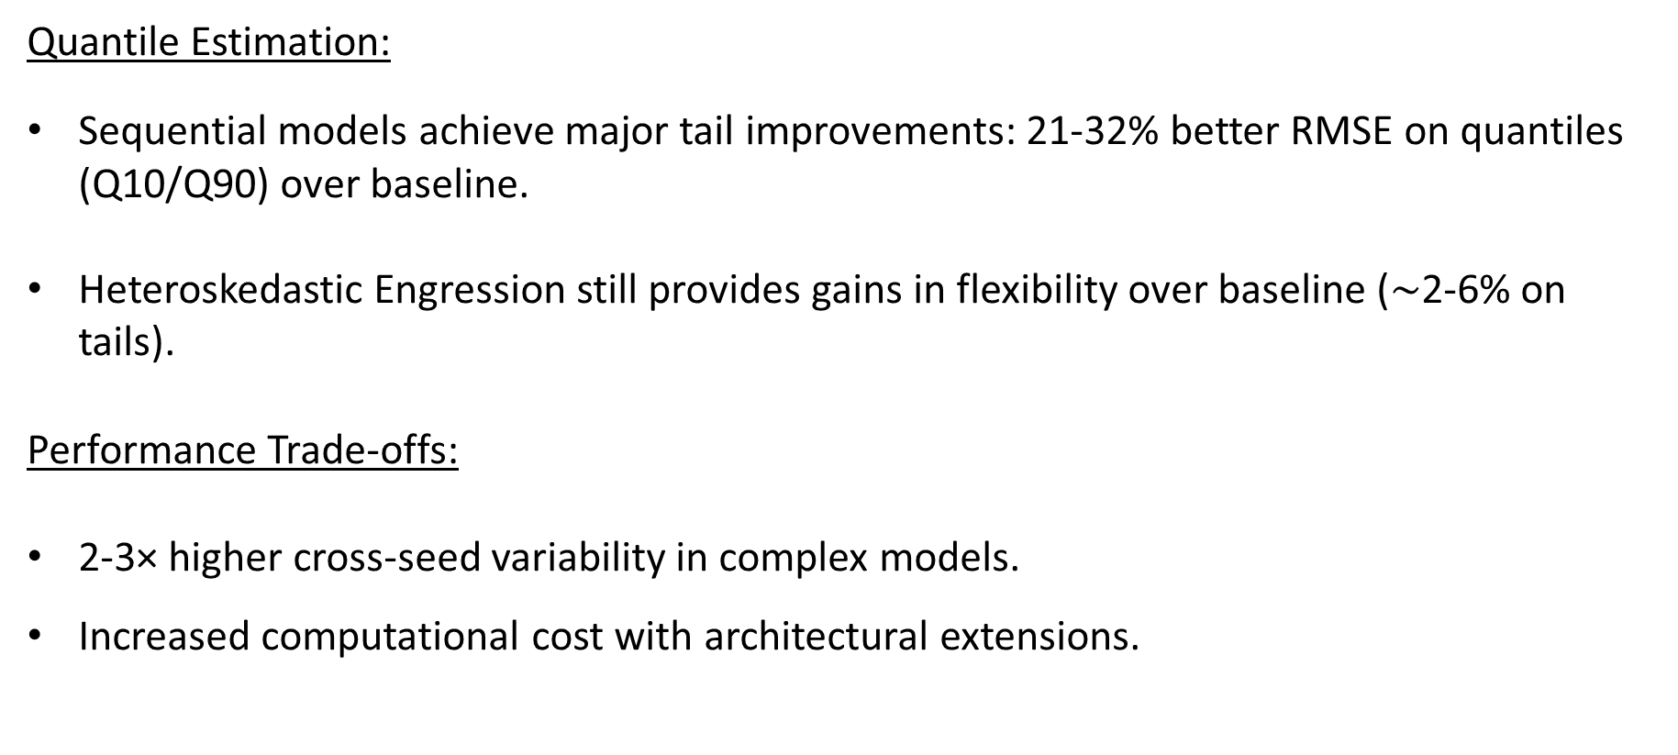
Experiments: Simulation Study
Quantile Estimation:
Sequential models achieve major tail improvements: 21-32% better RMSE on quantiles (Q10/Q90) over baseline.
Heteroskedastic Engression still provides gains in flexibility over baseline ($\sim$2-6% on tails).
Performance Trade-offs:
2-3× higher cross-seed variability in complex models.
Increased computational cost with architectural extensions.

Slide 23
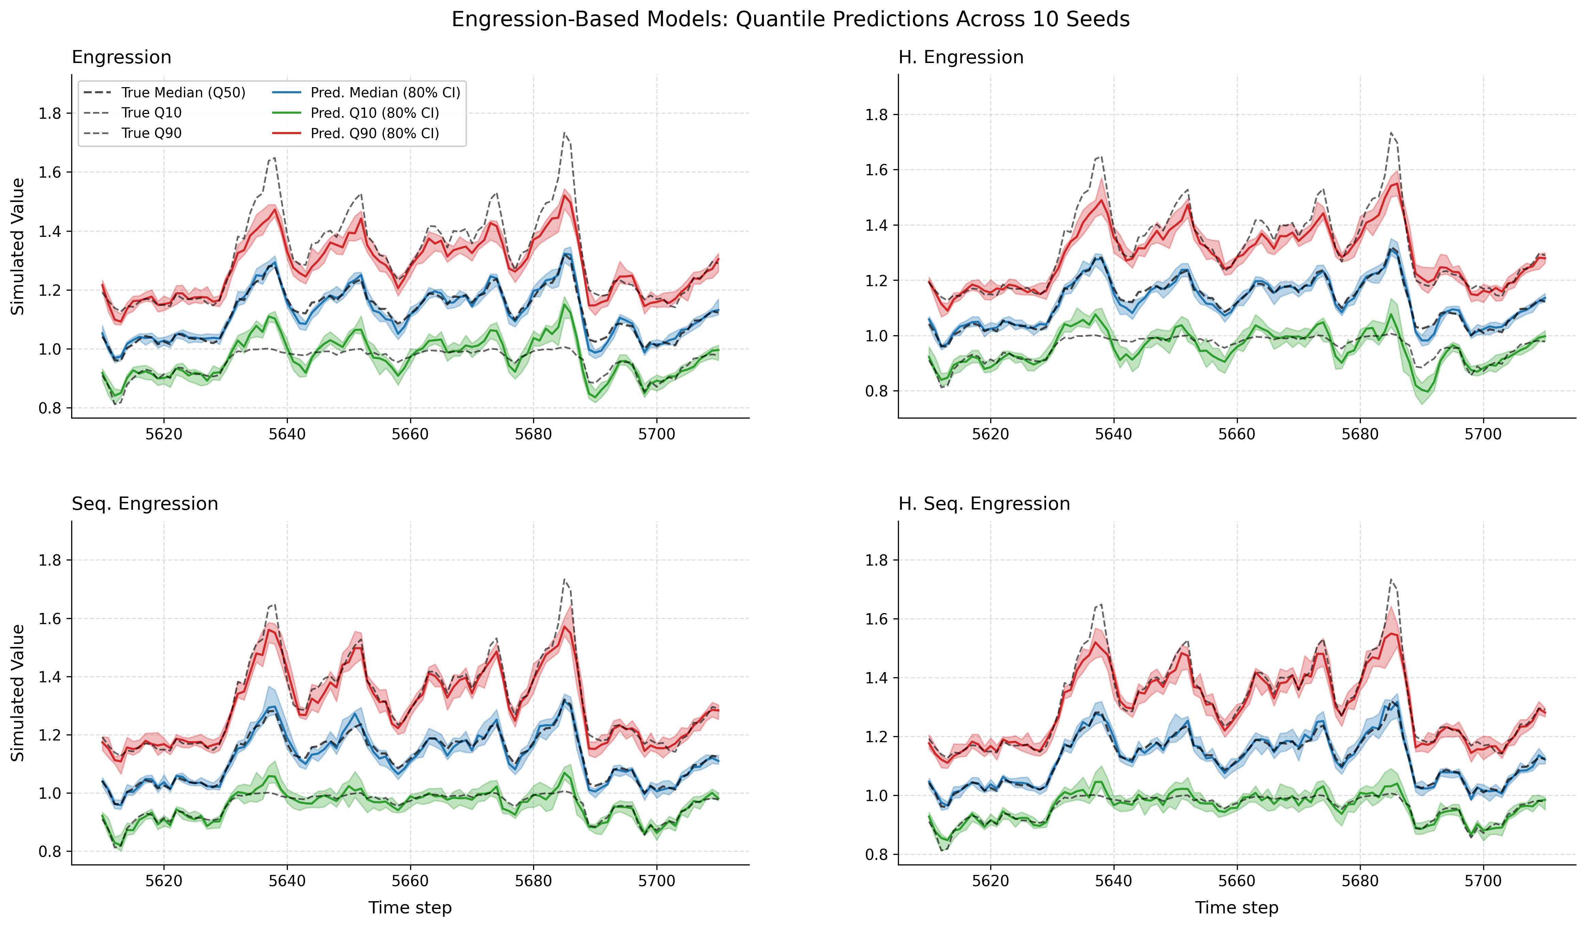
Experiments: Simulation Study

Slide 24
Experiments: River Discharge Application
Motivation:
Real-world application assessing model robustness in challenging conditions.
Complex temporal dependencies from multiple physical processes.
Non-stationary behavior from long-term climatic changes.
Practical relevance for flood risk assessment in extreme event (August 2005)
Dataset: Swiss Aare river at Bern-Schönau(1930-2014).
Response: Daily average discharge (m³/s) at Bern-Schönau gauging station.
Covariates: 7 upstream measurements (1 discharge from Gsteig + 6 precipitation stations).

Slide 25
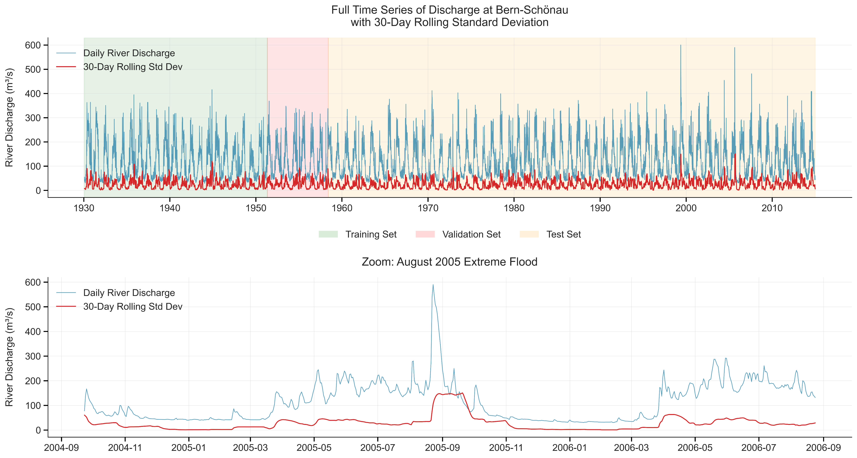
Experiments: River Discharge Application
Experimental Setup:

Slide 26
Experiments: River Discharge Application
Key Findings:
Sequential Models Underperform in Mean Prediction:
2-3% worse RMSE, 44-65% worse extreme prediction than non-sequential variants.
Daily aggregation weakens sequential signals.
Engression Robustness Even Under Misspecification:
7-9% lower RMSE, 9-20% better extreme prediction vs deterministic models.
Performance maintained despite suboptimal alignment with data structure.
Heteroskedastic Extensions Improve Distributional Quality:
Best when combined with temporal encoder (Heteroskedastic Sequential Engression), competitive standalone (Heteroskedastic Engression).
Critical for capturing time-varying volatility and adaptive uncertainty quantification.

Slide 27
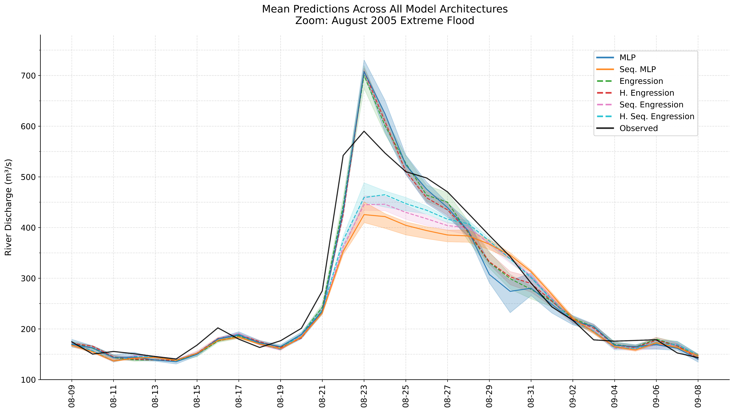
Experiments: River Discharge Application

Slide 28
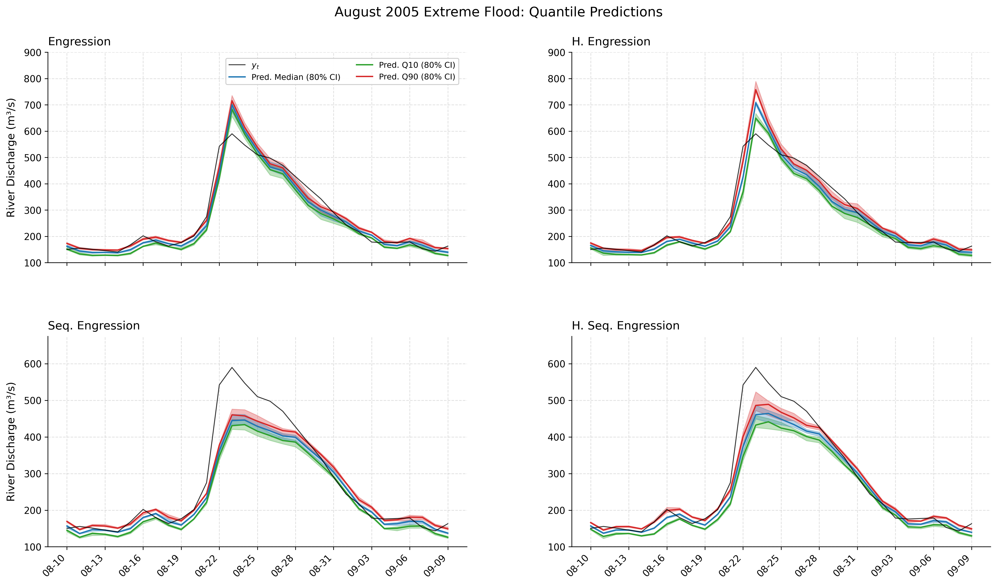
Experiments: River Discharge Application

Slide 29
Conclusion
Main Findings:
Successfully extended Engression to temporal forecasting via temporal encoder and heteroskedastic noise mechanisms.
Engression-based models achieve comparable mean prediction with superior extreme event forecasting compared to the respective deterministic baselines.
Extensions show context-dependent benefits by improving asymmetric tail forecasting and adaptive uncertainty quantification.

Slide 30
Conclusion
Key Limitations:
Limited empirical validation with two case studies. Broader temporal domains required for generalizability.
Complex simulation design complicated isolation of individual architectural contributions.
Computational resource limitations constrained experimental design and hyperparameter exploration.

